Slide 1

Java Certifications Which? How?
DISCOUNT CODE: TWITSPL40

Slide 2





youtube.com/c/laurentiuspilca
@laurspilca
Laurentiu Spilca
Notes:
Elements (version 1)
Elements are used to give more detail to a set of ideas, they should all relate to the same topic.
For example, use this page for a list of deliverables, key roles on a project, phases of a project, or any topic that can be broken down into more specific examples.
Each section should have an icon that relates to the content of that specific element, no icon should be repeated on the same page, and they should all be the same colour.
Keep the text to 1-2 sentences and aim to have about the same amount of content under each element.

Slide 3
OCP 11
Spring Framework
Java / Jakarta EE
Notes:
Elements (version 1)
Elements are used to give more detail to a set of ideas, they should all relate to the same topic.
For example, use this page for a list of deliverables, key roles on a project, phases of a project, or any topic that can be broken down into more specific examples.
Each section should have an icon that relates to the content of that specific element, no icon should be repeated on the same page, and they should all be the same colour.
Keep the text to 1-2 sentences and aim to have about the same amount of content under each element.

Slide 4
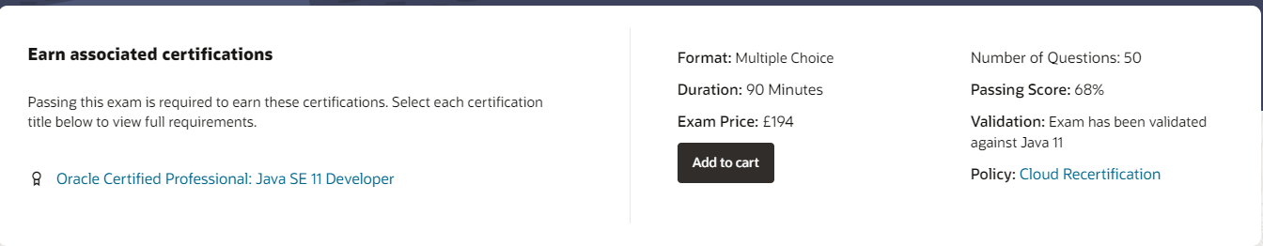
Oracle Certified Professional 11 – OCP 11
https://education.oracle.com/java-se-11-developer/pexam_1Z0-819
Notes:
Elements (version 1)
Elements are used to give more detail to a set of ideas, they should all relate to the same topic.
For example, use this page for a list of deliverables, key roles on a project, phases of a project, or any topic that can be broken down into more specific examples.
Each section should have an icon that relates to the content of that specific element, no icon should be repeated on the same page, and they should all be the same colour.
Keep the text to 1-2 sentences and aim to have about the same amount of content under each element.

Slide 5


Oracle Certified Professional 11 – OCP 11
Java SE 11 Programmer I Certification Guide
by Mala Gupta
OCP Oracle Certified Professional Java SE 11 Developer Complete Study Guide
by Jeanne Boyarsky, Scott Selikoff
Notes:
Elements (version 1)
Elements are used to give more detail to a set of ideas, they should all relate to the same topic.
For example, use this page for a list of deliverables, key roles on a project, phases of a project, or any topic that can be broken down into more specific examples.
Each section should have an icon that relates to the content of that specific element, no icon should be repeated on the same page, and they should all be the same colour.
Keep the text to 1-2 sentences and aim to have about the same amount of content under each element.

Slide 6

Oracle Certified Professional 11 – OCP 11
https://enthuware.com/java-certification-mock-exams/oracle-certified-professional/ocp-java-11-exam-1z0-819
Notes:
Elements (version 1)
Elements are used to give more detail to a set of ideas, they should all relate to the same topic.
For example, use this page for a list of deliverables, key roles on a project, phases of a project, or any topic that can be broken down into more specific examples.
Each section should have an icon that relates to the content of that specific element, no icon should be repeated on the same page, and they should all be the same colour.
Keep the text to 1-2 sentences and aim to have about the same amount of content under each element.

Slide 7

VMware Spring Professional 2021
https://www.vmware.com/education-services/certification/vcp-spring.html
Notes:
Elements (version 1)
Elements are used to give more detail to a set of ideas, they should all relate to the same topic.
For example, use this page for a list of deliverables, key roles on a project, phases of a project, or any topic that can be broken down into more specific examples.
Each section should have an icon that relates to the content of that specific element, no icon should be repeated on the same page, and they should all be the same colour.
Keep the text to 1-2 sentences and aim to have about the same amount of content under each element.

Slide 8
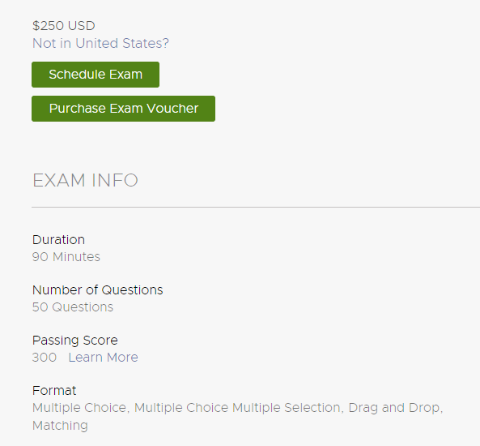
VMware Spring Professional 2021
https://www.vmware.com/content/dam/digitalmarketing/vmware/en/pdf/certification/vmw-spring-professional-certification-study-guide.pdf
Notes:
Elements (version 1)
Elements are used to give more detail to a set of ideas, they should all relate to the same topic.
For example, use this page for a list of deliverables, key roles on a project, phases of a project, or any topic that can be broken down into more specific examples.
Each section should have an icon that relates to the content of that specific element, no icon should be repeated on the same page, and they should all be the same colour.
Keep the text to 1-2 sentences and aim to have about the same amount of content under each element.

Slide 9

VMware Spring Professional 2021
Notes:
Elements (version 1)
Elements are used to give more detail to a set of ideas, they should all relate to the same topic.
For example, use this page for a list of deliverables, key roles on a project, phases of a project, or any topic that can be broken down into more specific examples.
Each section should have an icon that relates to the content of that specific element, no icon should be repeated on the same page, and they should all be the same colour.
Keep the text to 1-2 sentences and aim to have about the same amount of content under each element.

Slide 10



VMware Spring Professional 2021
Notes:
Elements (version 1)
Elements are used to give more detail to a set of ideas, they should all relate to the same topic.
For example, use this page for a list of deliverables, key roles on a project, phases of a project, or any topic that can be broken down into more specific examples.
Each section should have an icon that relates to the content of that specific element, no icon should be repeated on the same page, and they should all be the same colour.
Keep the text to 1-2 sentences and aim to have about the same amount of content under each element.

Slide 11
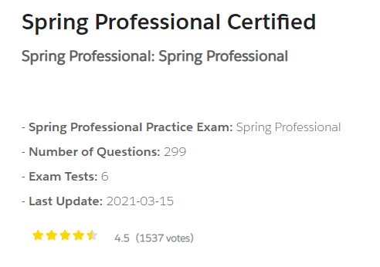
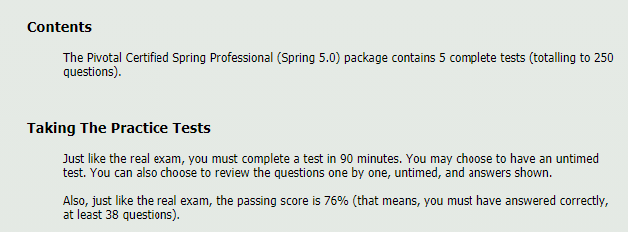
VMware Spring Professional 2021
https://www.certification-questions.com/practice-exam/spring/professional
http://itestjava.com/java-certification-practice-tests/product/enter.do?product=SPRING-CORE50
Notes:
Elements (version 1)
Elements are used to give more detail to a set of ideas, they should all relate to the same topic.
For example, use this page for a list of deliverables, key roles on a project, phases of a project, or any topic that can be broken down into more specific examples.
Each section should have an icon that relates to the content of that specific element, no icon should be repeated on the same page, and they should all be the same colour.
Keep the text to 1-2 sentences and aim to have about the same amount of content under each element.

Slide 12
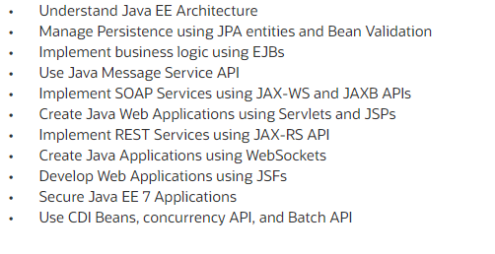
JAVA EE 7 CERTIFICATION
https://education.oracle.com/oracle-certified-professional-java-ee-7-application-developer/trackp_900
Notes:
Elements (version 1)
Elements are used to give more detail to a set of ideas, they should all relate to the same topic.
For example, use this page for a list of deliverables, key roles on a project, phases of a project, or any topic that can be broken down into more specific examples.
Each section should have an icon that relates to the content of that specific element, no icon should be repeated on the same page, and they should all be the same colour.
Keep the text to 1-2 sentences and aim to have about the same amount of content under each element.

Slide 13
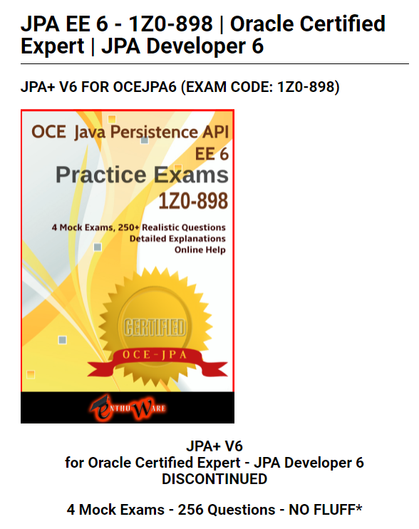
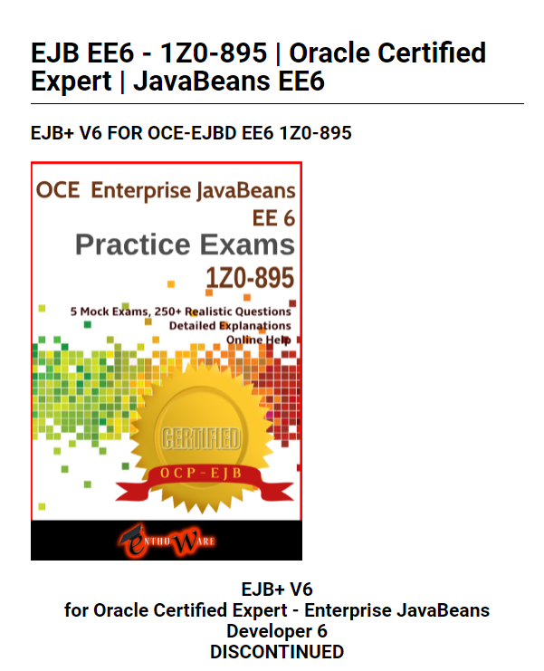
JAVA EE 7 CERTIFICATION
Notes:
Elements (version 1)
Elements are used to give more detail to a set of ideas, they should all relate to the same topic.
For example, use this page for a list of deliverables, key roles on a project, phases of a project, or any topic that can be broken down into more specific examples.
Each section should have an icon that relates to the content of that specific element, no icon should be repeated on the same page, and they should all be the same colour.
Keep the text to 1-2 sentences and aim to have about the same amount of content under each element.

Slide 14
youtube.com/c/laurentiuspilca
@laurspilca
Laurentiu Spilca
DISCOUNT CODE: TWITSPL40

